Slide 1
Introduction
to Probability

Slide 2
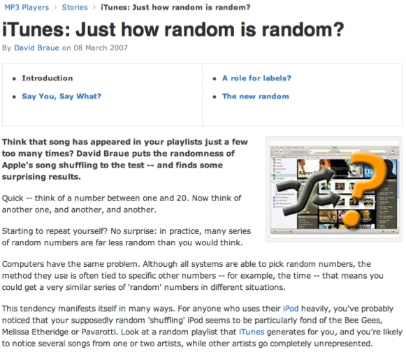
Random processes
A random process is a situation in which we know what outcomes could happen, but we don't know which particular outcome will happen.
Examples: coin tosses, die rolls, iTunes shuffle, whether the stock market goes up or down tomorrow, etc.
http://www.cnet.com.au/itunes-just-how-random-is-random-339274094.htm

Slide 3
Sample space
Sample space is the collection of all possible outcomes of a trial.
A couple has one kid, what is the sample space for the gender of this kid? S = {M, F}
A couple has two kids, what is the sample space for the gender of these kids?

Slide 4
Sample space
Sample space is the collection of all possible outcomes of a trial.
A couple has one kid, what is the sample space for the gender of this kid? S = {M, F}
A couple has two kids, what is the sample space for the gender of these kids?
S = {MM, FF, FM, MF}

Slide 5
Probability
There are several possible interpretations of probability but they (almost) completely agree on the mathematical rules probability must follow.
P(A) = Probability of event A
0 ≤ P(A) ≤ 1

Slide 6
Probability
There are several possible interpretations of probability but they (almost) completely agree on the mathematical rules probability must follow.
P(A) = Probability of event A
0 ≤ P(A) ≤ 1
Frequentist interpretation:
The probability of an outcome is the proportion of times the outcome would occur if we observed the random process an infinite number of times.

Slide 7
Practice
Which of the following events would you be most surprised by?
(a) exactly 3 heads in 10 coin flips
(b) exactly 3 heads in 100 coin flips
(c) exactly 3 heads in 1000 coin flips

Slide 8
Practice
Which of the following events would you be most surprised by?
(a) exactly 3 heads in 10 coin flips
(b) exactly 3 heads in 100 coin flips
(c) exactly 3 heads in 1000 coin flips

Slide 9
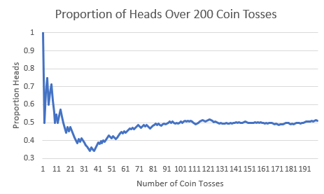
Law of large numbers
Law of large numbers states that as more observations are collected, the proportion of occurrences with a particular outcome converges to the probability of that outcome.

Slide 10
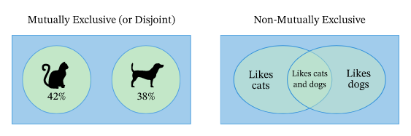
Disjoint and non-disjoint outcomes
Disjoint (mutually exclusive) outcomes: Cannot happen at the same time.
Non-disjoint outcomes: Can happen at the same time.

Slide 11
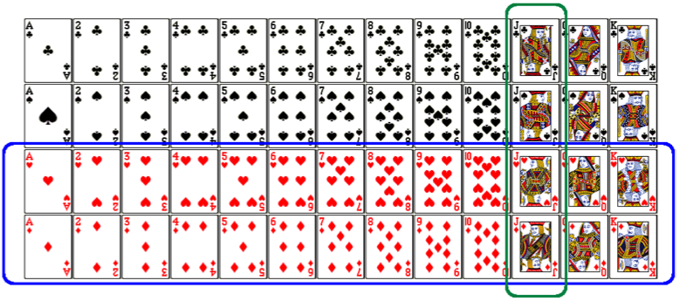
Union of non- mutually exclusive events
What is the probability of drawing a jack or a red card from a well shuffled full deck?
Figure from http://www.milefoot.com/math/discrete/counting/cardfreq.htm

Slide 12
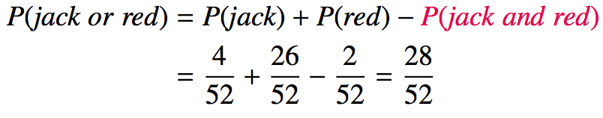
Union of non- mutually exclusive events
What is the probability of drawing a jack or a red card from a well shuffled full deck?
Figure from http://www.milefoot.com/math/discrete/counting/cardfreq.htm

Slide 13
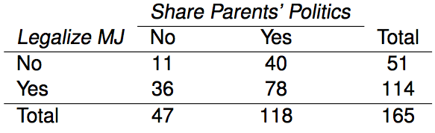
Practice
What is the probability that a randomly sampled student thinks marijuana should be legalized or they agree with their parents' political views?

Slide 14
Practice
What is the probability that a randomly sampled student thinks marijuana should be legalized or they agree with their parents' political views?
(114 + 118 - 78) / 165

Slide 15
Addition Rule
General addition rule
P(A or B) = P(A) + P(B) - P(A and B)
Note: For disjoint events P(A and B) = 0, so the above formula simplifies to P(A or B) = P(A) + P(B)

Slide 16
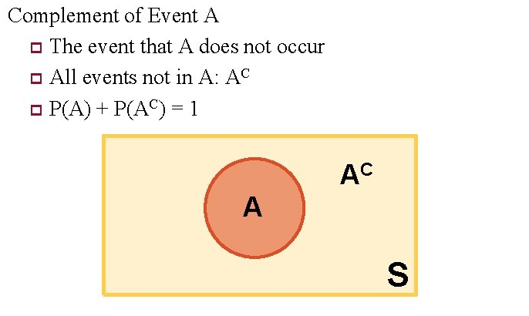
Complements

Slide 17
Independence
Two processes are independent if knowing the outcome of one provides no useful information about the outcome of the other.

Slide 18
Independence
Two processes are independent if knowing the outcome of one provides no useful information about the outcome of the other.
Knowing that the coin landed on a head on the first toss does not provide any useful information for determining what the coin will land on in the second toss. >> Outcomes of two tosses of a coin are independent.

Slide 19
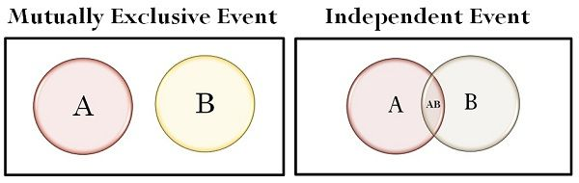
Independent vs. Mutually Exclusive

Slide 20
Practice
Between January 9-12, 2013, SurveyUSA interviewed a random sample of 500 NC residents asking them whether they think widespread gun ownership protects law abiding citizens from crime, or makes society more dangerous. 58% of all respondents said it protects citizens. 67% of White respondents shared this view. Which of the below is true?
Opinion on gun ownership and race ethnicity are most likely
(a) complementary
(b) mutually exclusive
(c) independent
(d) dependent
(e) disjoint
http://www.surveyusa.com/client/PollReport.aspx?g=a5f460ef-bba9-484b-8579-1101ea26421b

Slide 21
Practice
Between January 9-12, 2013, SurveyUSA interviewed a random sample of 500 NC residents asking them whether they think widespread gun ownership protects law abiding citizens from crime, or makes society more dangerous. 58% of all respondents said it protects citizens. 67% of White respondents shared this view. Which of the below is true?
Opinion on gun ownership and race ethnicity are most likely
(a) complementary
(b) mutually exclusive
(c) independent
(d) dependent
(e) disjoint
http://www.surveyusa.com/client/PollReport.aspx?g=a5f460ef-bba9-484b-8579-1101ea26421b

Slide 22
Checking for independence
If P(A and B) = P(A) × P(B) then A and B are independent.

Slide 23
Multiplication rule for independent events
If events A and B are independent,
P(A and B) = P(A) x P(B)
Or more generally, P(A₁, and, … and A_{k}) = P(A₁) x … x P(A_{k})

Slide 24
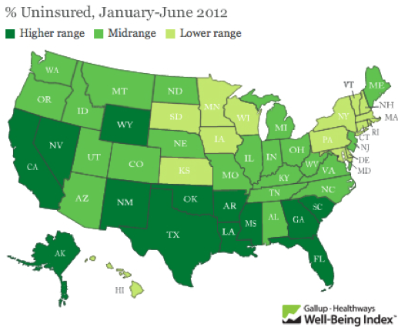
Practice
A recent Gallup poll suggests that 25.5% of Texans do not have health insurance as of June 2012. Assuming that the uninsured rate stayed constant, what is the probability that two randomly selected Texans are both uninsured?
(a) 25.5²
(b) 0.255²
(c) 0.255 x 2
(d) (1 - 0.255)²
http://www.gallup.com/poll/156851/uninsured-rate-stable-across-states-far-2012.aspx

Slide 25
Practice
A recent Gallup poll suggests that 25.5% of Texans do not have health insurance as of June 2012. Assuming that the uninsured rate stayed constant, what is the probability that two randomly selected Texans are both uninsured?
(a) 25.5²
(b) 0.255²
(c) 0.255 x 2
(d) (1 - 0.255)²
http://www.gallup.com/poll/156851/uninsured-rate-stable-across-states-far-2012.aspx

Slide 26
Putting everything together...
If we were to randomly select 5 Texans, what is the probability that at least one is uninsured?
If we were to randomly select 5 Texans, the sample space for the number of Texans who are uninsured would be: S = {0, 1, 2, 3, 4, 5}
We are interested in instances where at least one person is uninsured: S = {0, 1, 2, 3, 4, 5}
So we can divide up the sample space into two categories: S = {0, at least one}

Slide 27
Putting everything together...
Since the probability of the sample space must add up to 1:
P(at least 1 uninsured)
= 1 - P(none uninsured)

Slide 28
Putting everything together...
Since the probability of the sample space must add up to 1:
P(at least 1 uninsured)
= 1 - P(none uninsured)
= 1 - (1 - 0.255)⁵
= 1 - 0.745⁵

Slide 29
Putting everything together...
Since the probability of the sample space must add up to 1:
P(at least 1 uninsured)
= 1 - P(none uninsured)
= 1 - (1 - 0.255)⁵
= 1 - 0.745⁵
= 1 - 0.23
= 0.77

Slide 30
Practice
Roughly 20% of undergraduates at a university are vegetarian or vegan. What is the probability that, among a random sample of 3 undergraduates, at least one is vegetarian or vegan?
(a) 1 - 0.2 x 3
(b) 1 - 0.2³
(c) 0.8³
(d) 1 - 0.8 x 3
(e) 1 - 0.8³

Slide 31
Practice
Roughly 20% of undergraduates at a university are vegetarian or vegan. What is the probability that, among a random sample of 3 undergraduates, at least one is vegetarian or vegan?
(a) 1 - 0.2 x 3
(b) 1 - 0.2³
(c) 0.8³
(d) 1 - 0.8 x 3
(e) 1 - 0.8³
P(at least 1 from veg)
= 1 - P(none veg)
= 1 - 0.8³
= 1 - 0.512 = 0.488

Slide 32
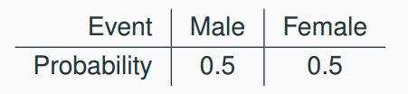
Probability distributions
A probability distribution for a discrete variable lists all possible events and the probabilities with which they occur.
The probability distribution for the gender of one kid:
Rules for probability distributions:
1. The events listed must be mutually exclusive
2. Each probability must be between 0 and 1
3. The probabilities must total 1

Slide 33
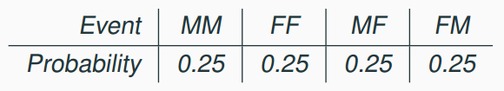
Probability distributions
A probability distribution for a discrete variable lists all possible events and the probabilities with which they occur.
The probability distribution for the genders of two kids:

